Slide 1
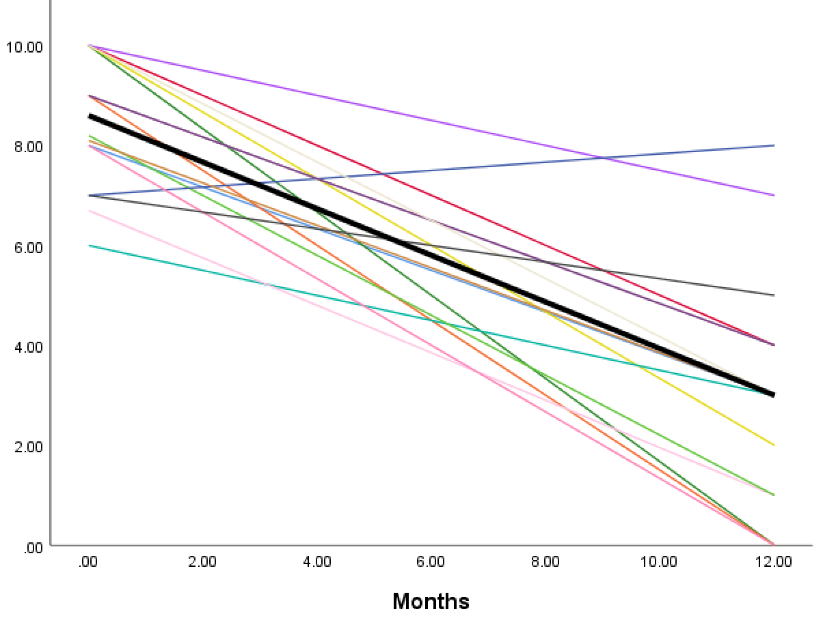
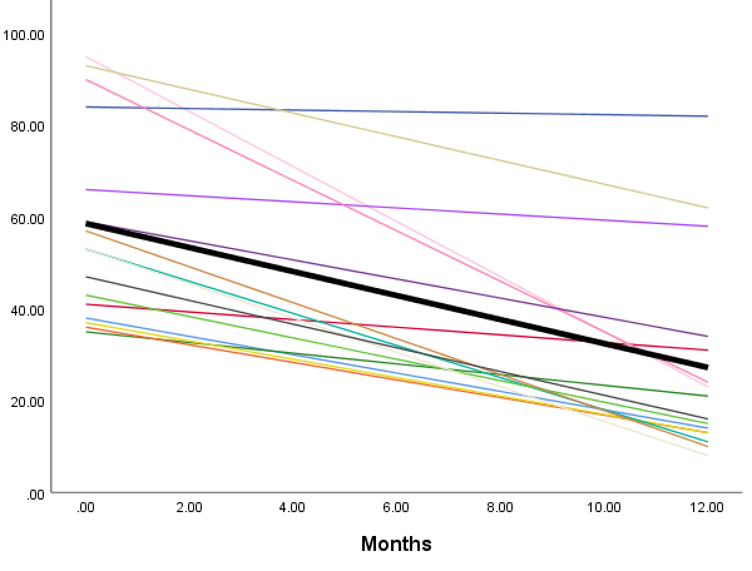
The Outcome of Expandable Titanium Cages in Vertebral Compression Fractures Caused by Myeloma
Islim AI^{1,2}, Gandham S¹, Alhamad S¹ & Thambiraj S¹
¹ Department of Spinal Surgery, Royal Liverpool University Hospital, Liverpool, UK; ² School of Medicine, Faculty of Health and Life Sciences, University of Liverpool, Liverpool, UK
BACKGROUND
RESULTS
Myeloma constitutes 2% of all cancer cases in the UK
Vertebral compression fractures (VCF) occur in 34% to 64% of patients
VCF results in pain, spinal deformity and reduced health related quality of life
VCFs that fail conservative management can be subject to operative augmentation
NICE and the International Myeloma Working Group (IMWG) advocate conventional vertebroplasty and balloon kyphoplasty techniques
These however yield a leakage rate up to 20% and don’t restore lost vertebral height
To address these shortcoming, 3rd generation techniques including expandable titanium cages have been developed. These include Osseofix
Study population
16 patients
12:4
Average age 62
Median ASA 3
Surgery details
82 levels
5/patient
Thoracic spine
5 patients
Thoracic + lumbar spine
1 patient
Unipedicular 13
152 cages
10/patient
Bipedicular 69
Lumbar spine
10 patients
OBJECTIVE
Clinical outcomes
To evaluate clinical, radiological and patient reported outcomes (PRO) in a series of patients with VCF secondary to myeloma treated with Osseofix
Zero complications
Median length of stay 1.5 days
METHODS
Data for patients between 2016-2018 were collected retrospectively
Eligibility criteria: Adults with multiple myeloma and ≥ 1 VCF who met the indication for augmentation as per NICE and IMWG
Clinical variables: age, sex, ASA and intra/post-operative complications (including leakage and adjacent level #)
Radiological variables: n. of spinal levels corrected, n. of cages applied, change in kyphotic angle postoperatively (T cobb angle) and average vertebral height restoration (vertebral compression ratio)/patient
PROs: visual analogue scale (VAS) and Oswestry disability index (ODI) preoperatively and at 12 months post surgery
Wilcoxon signed rank and paired t tests used to examine longitudinal changes in outcome measures
Multivariate linear regression to predict VAS and ODI outcomes
Radiologic outcomes
Average VCR correctio
1.5%
Change in kyphotic angle
39.5 → 43.5 (p=0.215)
Zero
Adjacent level
#
Patient reported outcomes
VAS 8.6 → 3 (p<0.001)
ODI 58.6 → 27.2 (p<0.001)
↑cages was predictive of ODI (B-coefficient -4.29 [95%CI -7.29 - -1.29], p=0.008) and VAS (B-coefficient -0.48 [95%CI -0.97 - -0.002], p=0.049) improvement
Expandable titanium mesh cages are a safe and clinically effective method of relieving pain, improving function and stabilising VCF but not deformity correction. An increase by 1 cage improved ODI by 4 and VAS by 0.5; indicating more benefit in severe mutli-level disease
Notes:
`

